Slide 1

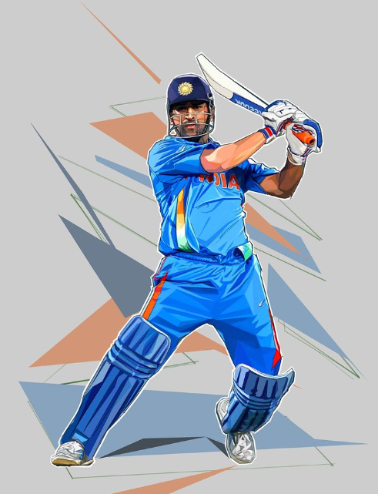

TURF HUB

Slide 2

Content
01
Problem Statement
02
Solutions
03
Benifits
04
Tech Stack
05
Modules Used
06
Outputs

Slide 3

Overview
The Turf Hub project connects sports enthusiasts with bookable turf fields, streamlining scheduling and management for users and facility owners
PROBLEM STATEMENT:
Sports enthusiasts often face difficulties in finding and booking available turf fields for their activities, leading to inefficiencies and lost opportunities. Facility owners struggle with managing reservations and maximizing their field utilization. This lack of a centralized, user-friendly platform results in a fragmented and time-consuming process for both users and owners. The Turf Hub project aims to address these issues by providing a streamlined, accessible solution for booking and managing turf fields. This will enhance user experience and operational efficiency for facility owners

Slide 4







SOLUTION
•The turf booking platform streamlines the process of finding and reserving turf facilities for sports activities. It offers advanced search filters, real-time availability updates, and secure online payments for sports teams, coaches, and individual players. With an intuitive admin panel, turf owners can efficiently manage listings and facility operations. This platform revolutionizes turf facility access and utilization, enhancing the overall sports experience for users.

Slide 5




TECH STACK
FRONTEND
EXPRESS
BACKEND
The frontend tech stack for the Turf Hub project includes React.js, Redux, CSS3, HTML5, and Bootstrap or Material-UI.
Express.js is used in the Turf Hub project for building the backend server and handling API requests and responses efficiently
The backend tech stack for the Turf Hub project includes Node.js, Express.js, MongoDB, Mongoose

Slide 6

MODULES USED
React: A JavaScript library for building user interfaces.
React-router-dom: Provides DOM bindings for React Router, enabling navigation and routing in React applications.
Axios: A promise-based HTTP client for making asynchronous HTTP requests in the browser and Node.js environment.
useState: A React Hook used for managing state in functional components.
Express: A web application framework for Node.js, used for building backend APIs and web servers.
BrowserRouter: A React Router component providing the router context for a React application using HTML5 history API.
Link: A React Router component used for creating links to different routes in a React application.

Slide 7
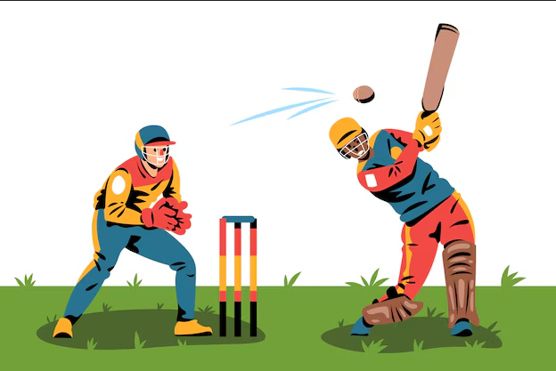
BENIFITS
Convenience: The platform offers a streamlined process for finding and booking turf facilities, saving users time and effort compared to traditional manual methods.
Accessibility: Users can access the platform from anywhere, at any time, using their desktop or mobile devices, providing convenience and flexibility in booking turf facilities.
Real-time Updates: Users receive real-time updates on turf availability, ensuring they can make informed booking decisions and avoid conflicts.
Secure Payments: The platform facilitates secure online payments, providing users with peace of mind when making transactions for turf bookings.
Efficient Management: Turf owners benefit from efficient management tools, allowing them to update listings, track bookings, and optimize facility operations for enhanced productivity and revenue generation.

Slide 8
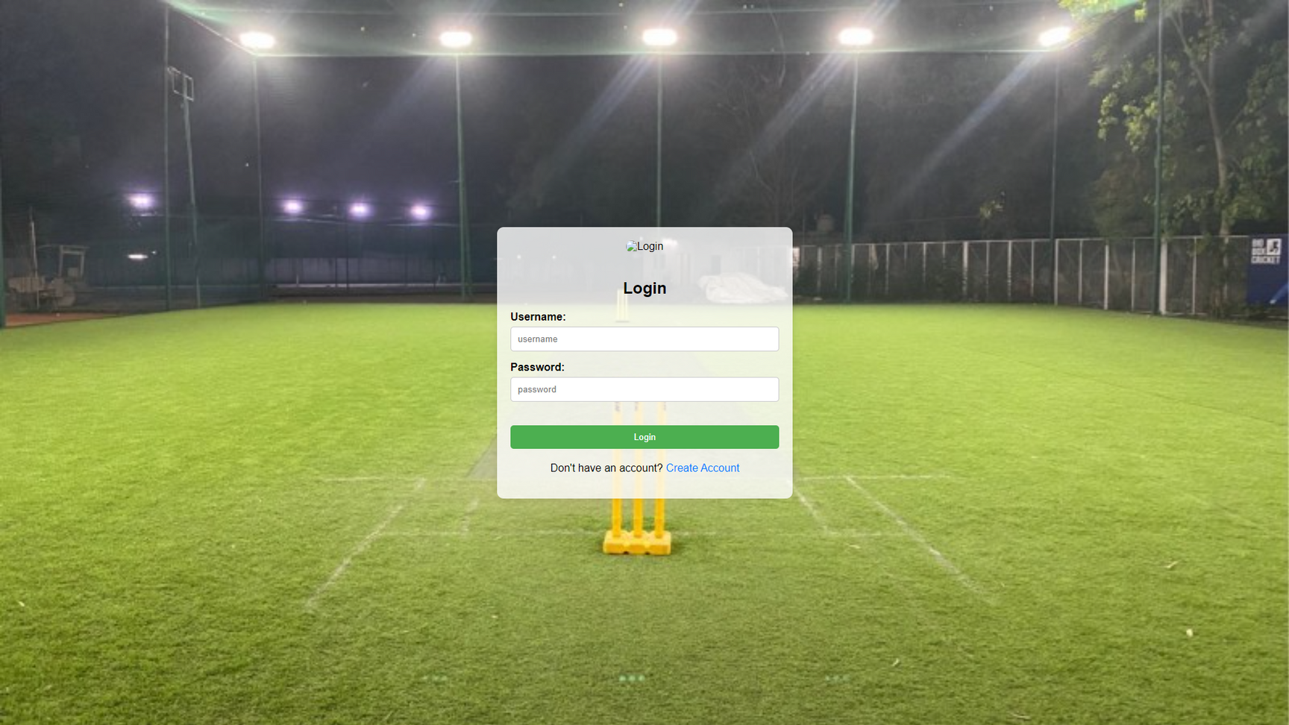
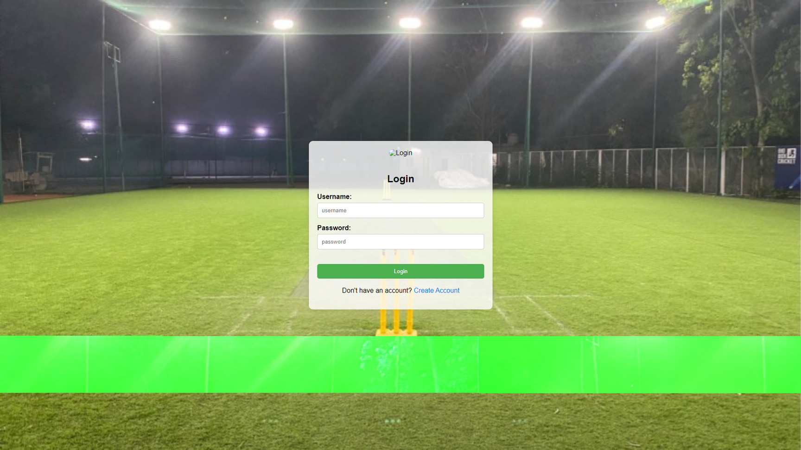
LOGIN PAGE

Slide 9
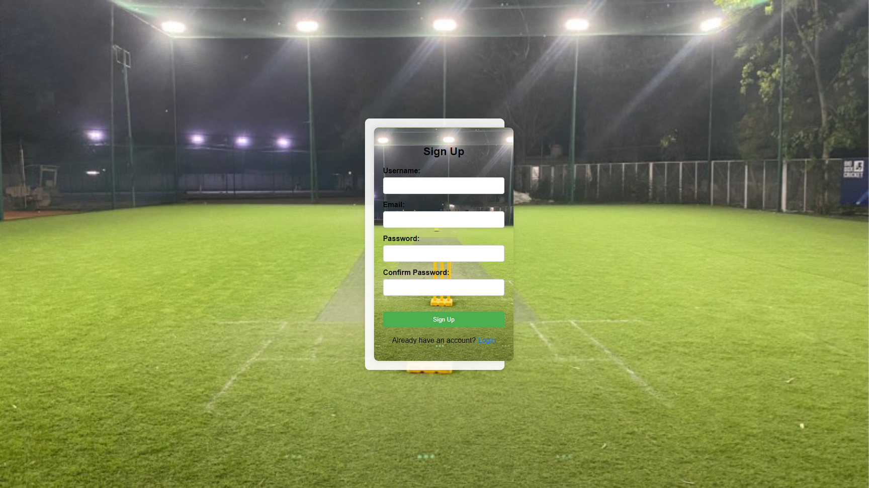
SIGNIN PAGE

Slide 10
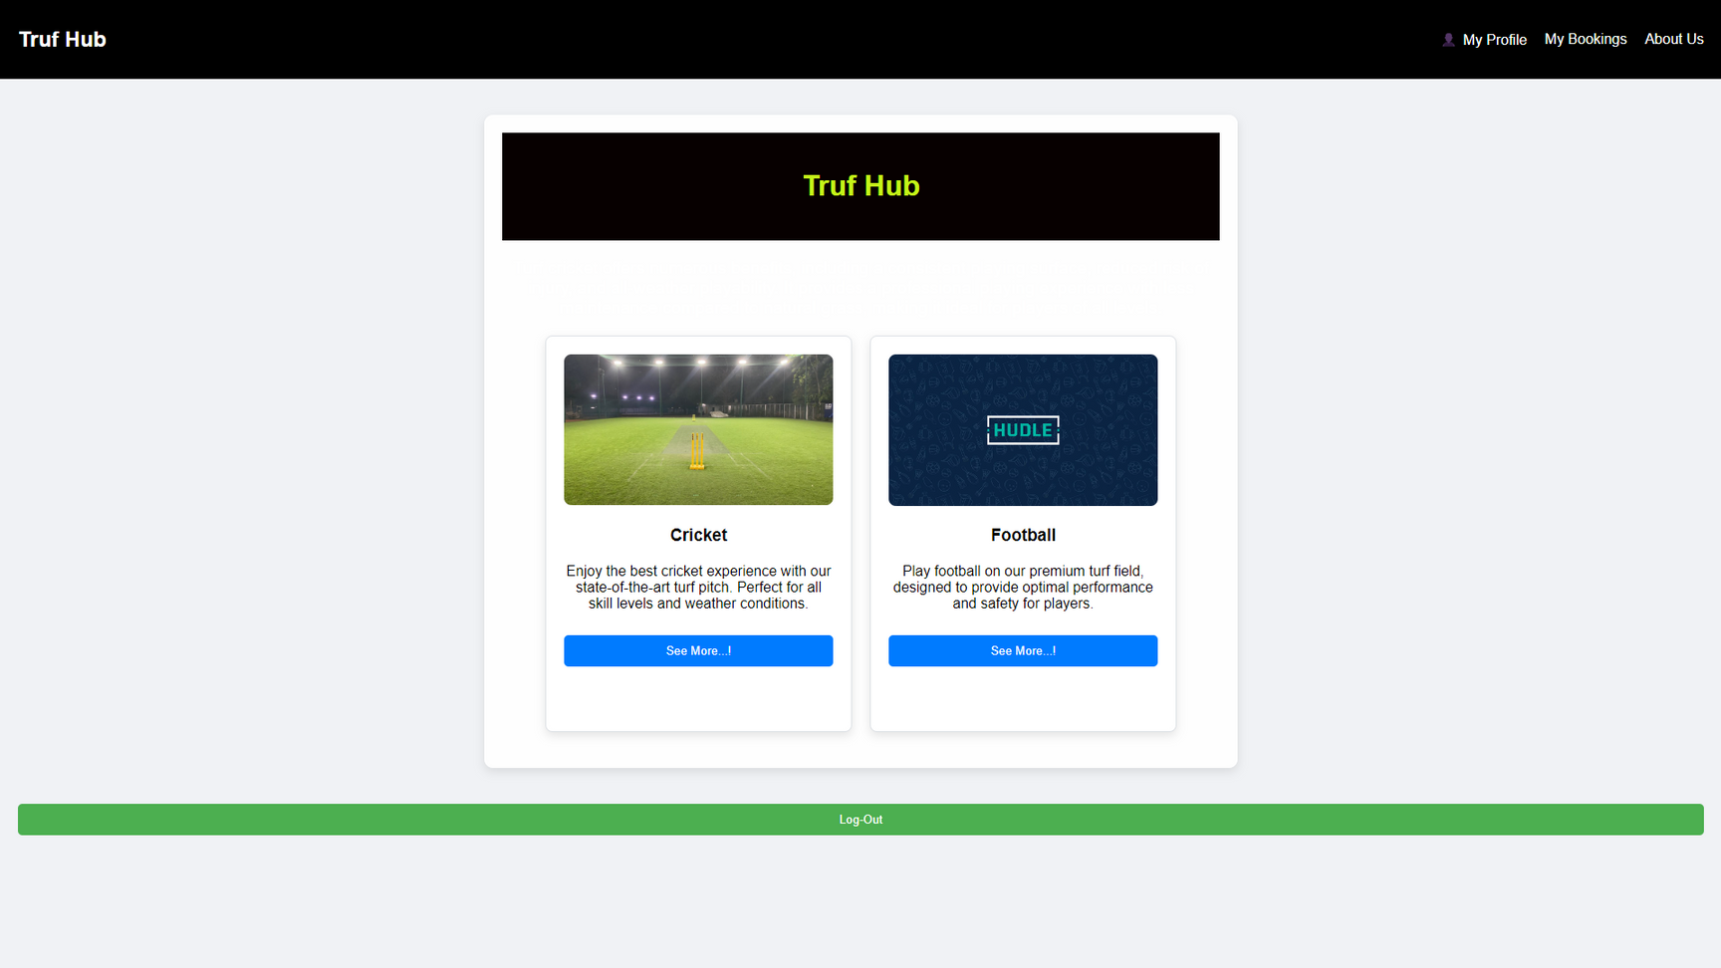
HOME PAGE

Slide 11
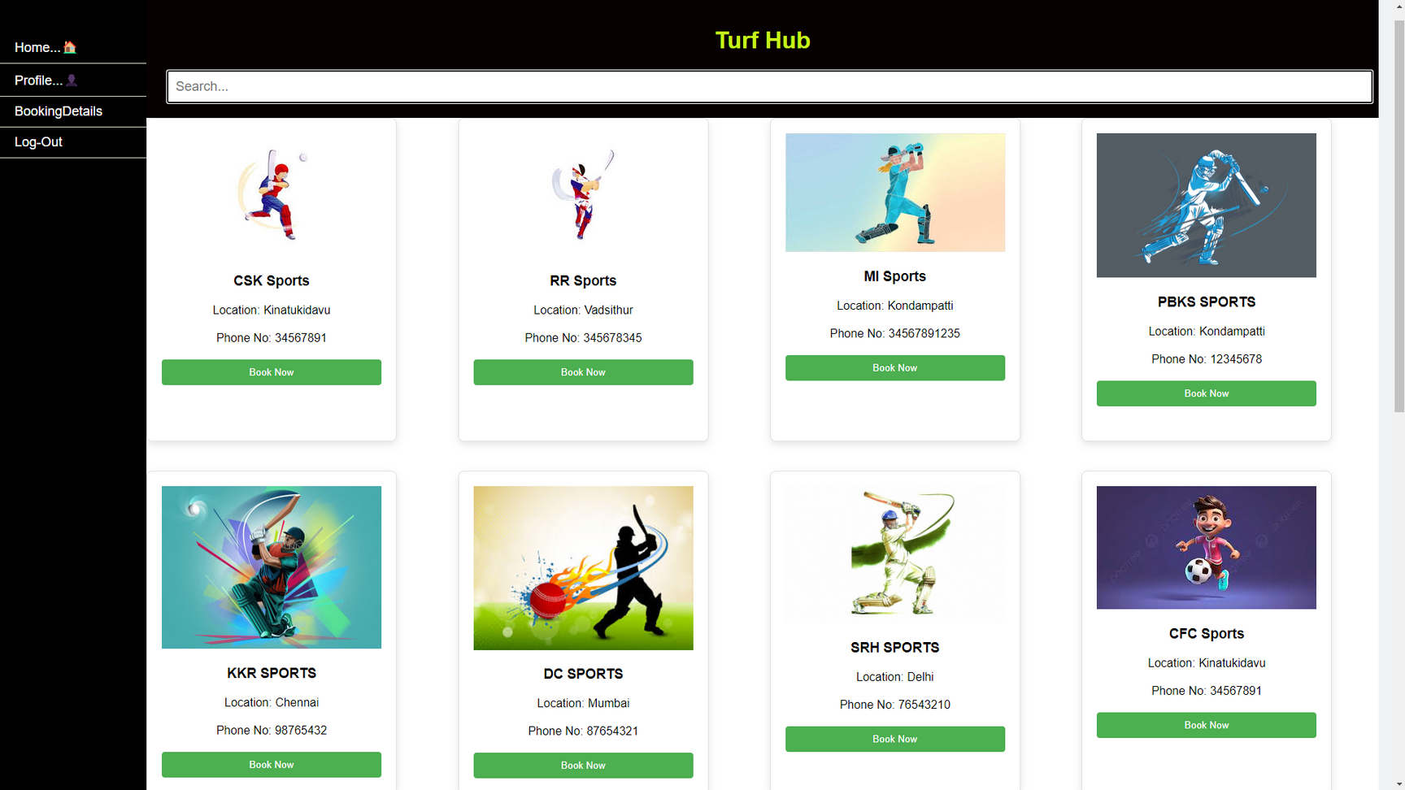
MAIN PAGE

Slide 12
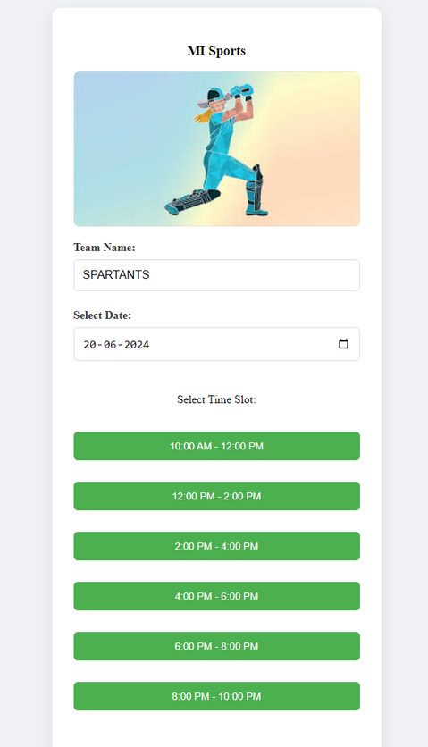
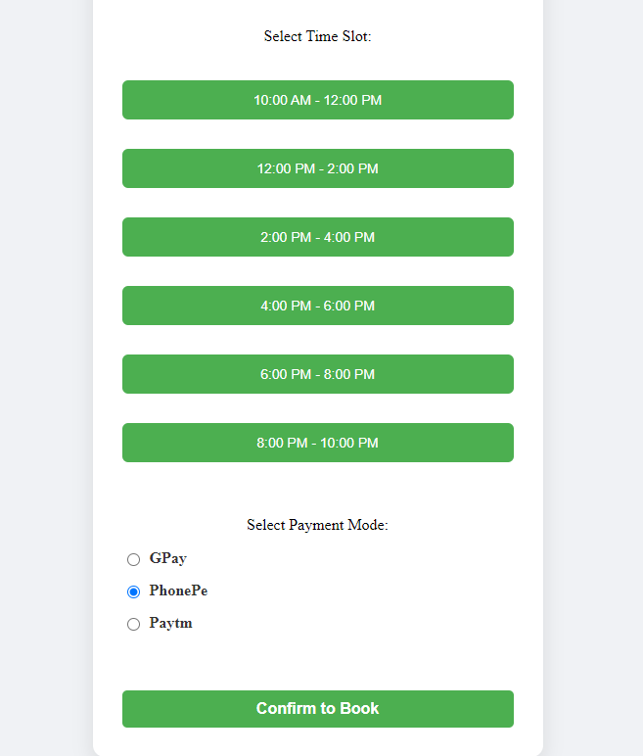
SLOT BOOKING PAGE

Slide 13
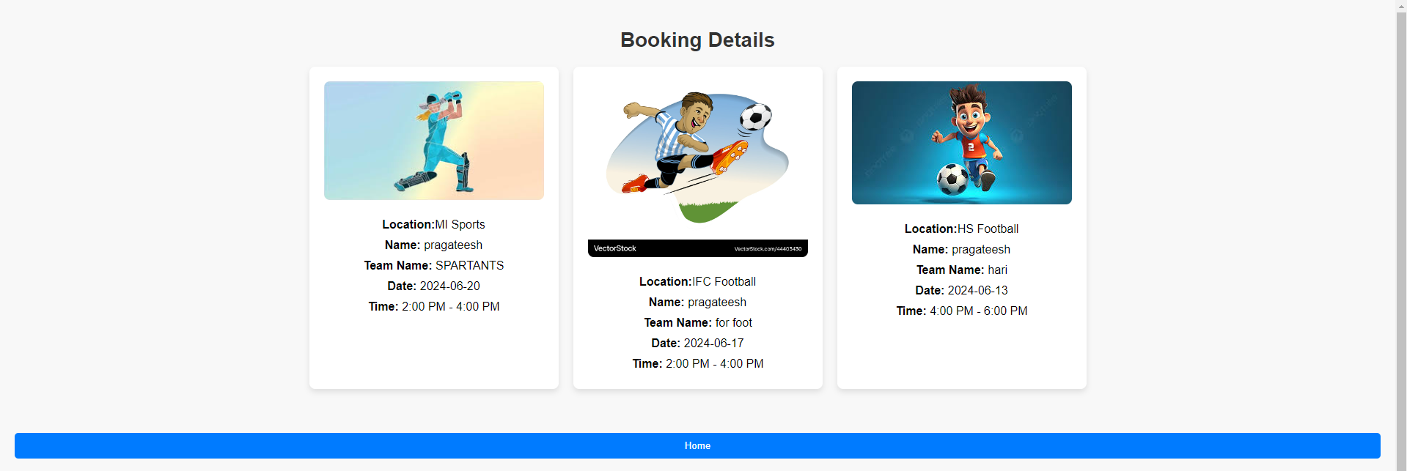
BOOKING DETAILS PAGE

Slide 14
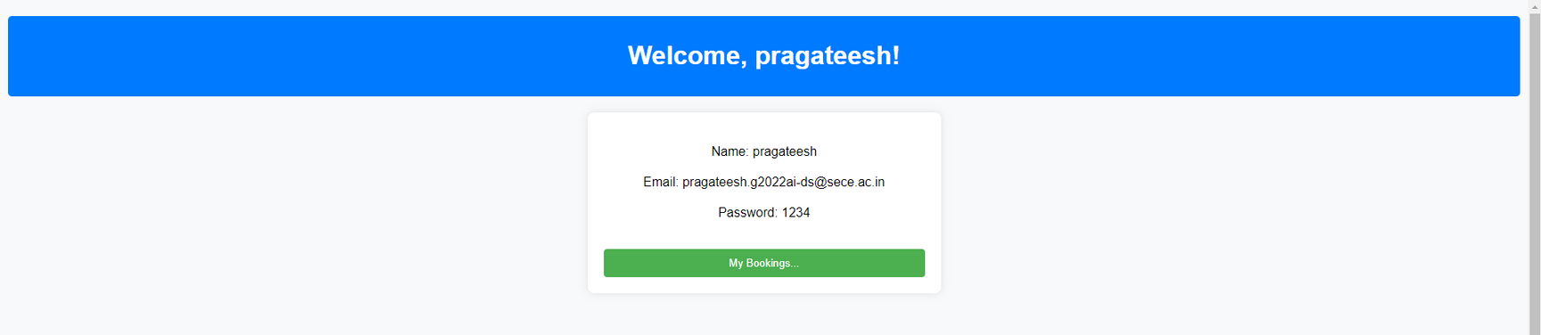
PROFILE PAGE

Slide 15

THANK YOU

